Slide 1
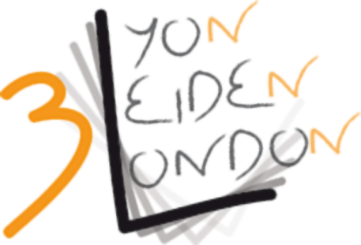
Twenty years on: Reassessing language documentation and revitalization
Institutionalizing endangered languages :
From language documentation & archiving
to revitalization
Colette Grinevald (ex Craig)
LED-TDR DDL

Slide 2
outline
Why 20 years? 1992-2012
The institutionalization of EL in the linguistic profession
Re-casting the story in LED TDR discourse
Today’s programme

Slide 3
1. Why « 20 years » ? 1992-2012
Admitedly an academic, linguistic, American perspective!
Two events
Linguistic Society of America (LSA) panel of 1991, published as:
Hale, K., M. Krauss, L. Watahomigie, A. Yamamoto, C. Craig, J. LaVerne & N. England. 1992. “Endangered Languages”. Language 68(1), 1-42.
International Congress of Linguists (ICL) Quebec, 1992.
Crochetière, A. et al (eds), 1993. Les langues menacées Vol. I, II. Proceedings of the XVth International Congress of Linguists, Presses de l’université Laval.

Slide 4
The 1991 LSA panel : engaged academic linguists
A United States perspective (Hale, Krauss, Yamamoto, Watahomigie, LaVerne)
mobilization in reaction to the «English only» movement
«Native Language Act» of 1990 (signed by Bush):
"the status of the cultures and languages of Native Americans is unique and the United States has the responsibility to act together with Native Americans to ensure the survival of these unique cultures and languages"
A Latin American perspective: 1492- 1992 (Hale, Craig, England)
mobilization in support of the Indigenous movement of protest against the
official 500th anniversary celebrations of the «discovery» of Latin America

Slide 5
An orchestrated three-voice discourse (1992)
Mike Krauss (Alaska):
- sounding the alarm , the «catastrophy» of language endangerment
- 50% to 90% of languages endangered; degrees of endangerment
“Obviously we must do some serious rethinking of our priorities, lest linguistics go down in history as the only science that presided obliviously over the disappearance of 90% of the very field to which it is dedicated”
Ken Hale (MIT) :
- what do we lose when we lose a language
- the auxiliary language Damin of Lardil (North Queensland, Australia)
“The loss of local languages, and of the cultural systems that they express, has meant irretrievable loss of diverse and interesting intellectual wealth, the priceless products of human mental industry.”

Slide 6
(3) Colette Craig (Oregon) :
[…] so, if you are convinced of the urgency, and plan on working on an EL, then, what about speakers and communities and what about fieldwork methods and ethics?
Grinevald, C., 2007. "Encounters at the brink: linguistic fieldwork among speakers of endangered languages", in The Vanishing Languages of the Pacific Rim, Miyaoka, O., Sakiyama, O. & Krauss, M. (eds), Oxford, Oxford University Press
Grinevald, C., 2007. "A view from the field: An Amerindian view, worrying about ethics and wondering about “informed consent” ", in Lesser Known Languages in South Asia: Status and policies, Case Studies and Applications of Information Technology, Saxena, A. & Borin, L. (eds), Lund, Mouton de Gruyter TiLSM 175
Grinevald, C & M. Bert 2010 (eds). Linguistique de terrain sur langues en danger, locuteurs et linguistes, Faits de Langues 35/36. Ophrys.
Grinevald, C. & Bert 2011. “Speakers and community”. In Austin Peter K. & Julia Sallabank (eds.), The Cambridge Handbook of Endangered Languages, Cambridge Handbooks in Language and Linguistics, 45-65. Cambridge: Cambridge University Press.

Slide 7
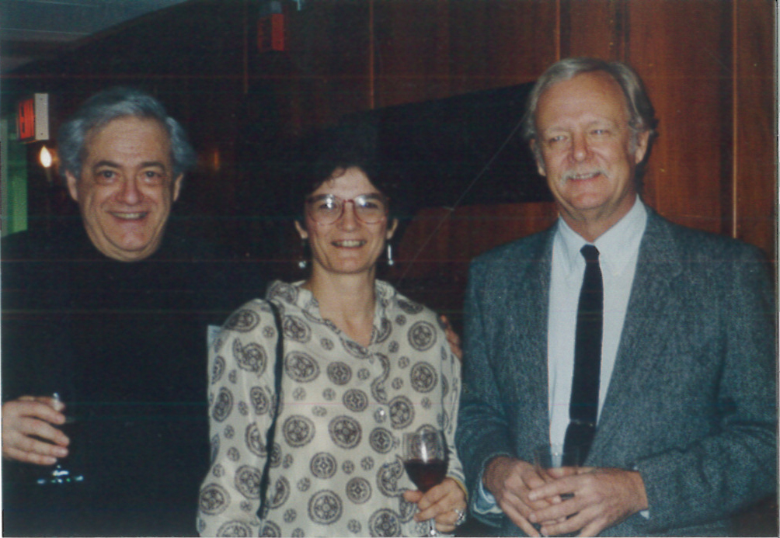
«The Dartmouth Conference» 1995 Krauss - Hale – Craig « the three stooges »
Grenoble & Whaley (Eds). 1998. Endangered languages – Current issues and future prospects. CUP
…. Brenzinger, England, Hinton….

Slide 8
Krauss – Hale – Craig: each his/her theme
Krauss, M. 1992. The world's languages in crisis. Language 68(1),1-42.
Krauss, M. 1993. The Language Extinction Catastrophe Just Ahead: Should Linguists Care? Actes du XVe Congrès International des Linguistes, pp. 43-46, Québec.
Hale, K. 1992. Language endangerment and the human value of linguistic diversity. Language 68 (1).
Hale, K. 1998. On endangered languages and the importance of linguistic diversity. In Lenore A Grenoble and J Whaley Lindsey, eds Endangered languages. 192-216. Cambridge: CUP.
Craig, C. 1992. A constitutional response to language endangerment: the case of Nicaragua. Language 68(1), 11-16.
Craig, C. 1993. Linguistic fieldwork on endangered languages: issues of methodology and ethics, in A. Crochetière et al , Les langues menacées Vol. I, Proceedings of the XVth International Congress of Linguists, Presses de l' Université Laval, pp. 33-42.

Slide 9
Tension in the linguistic world:
The reaction of linguists to the LSA panel and 1992 Language publication:
Ladefoged, W. 1992. Another view of endangered languages, Language 68-4 p809-811
And the reply :
Dorian, N. 1992 Response to Ladefoged’s other view of endangered languages. Language 69-3, p575-579
Dorian: a pionneer EL linguist!
Dorian, N. 1977. The Problem of the Semi-Speaker in Language Death. International Journal of the Sociology of Language 12, 23-32.
Dorian, N. 1981. Language Death: The Life Cycle of a Scottish Gaelic Dialect. Philadelphia: University of Pennsylvania Press.

Slide 10
2. The institutionalization of EL in the linguistic profession
The (inside story of) EL foundations:
VolkswagenStiftung (Germany): VW-DOBES 1998
HRELDP (Great Britain): ELDP, ELAP, ELAR 2001
DEL (USA): NSF, NEH, Smithsonian 2005

Slide 11
The UNESCO
Robins, R. & Uhlenbeck ( eds.). 1991. Endangered languages, OUP Presented at ICL Quebec, 1992
UNESCO. 2003. Language Vitality and Endangerment. Report of the International Expert Meeting on the UNESCO Programme “Safeguarding of Endangered Languages”, Paris / Fontenay
Experts: M. Brenzinger, A. M. Dwyer, Tjeerd de Graaf, C Grinevald, M. Krauss, O. Miyaoka, N. Ostler, O. Sakiyama, M. Villalón, A. Yamamoto & O. Zepeda
9 X Criteria for vitality
5 X Degrees of vitality (Krauss )
The UNESCO Atlas of the World’s languages in danger (2009)

Slide 12
3. Recasting the story in LED TDR parlance*
…in terms of ideologies, tensions, evolutions and synergies:
mapping out spheres of ideologies
exploring the academic sphere (the ivory tower)
With its tensions: individual reactions to 1992 coming-out
and its evolution :
the development of the sub-disciplines of « documentary linguistics »
in the context of synergies at the international level

Slide 13
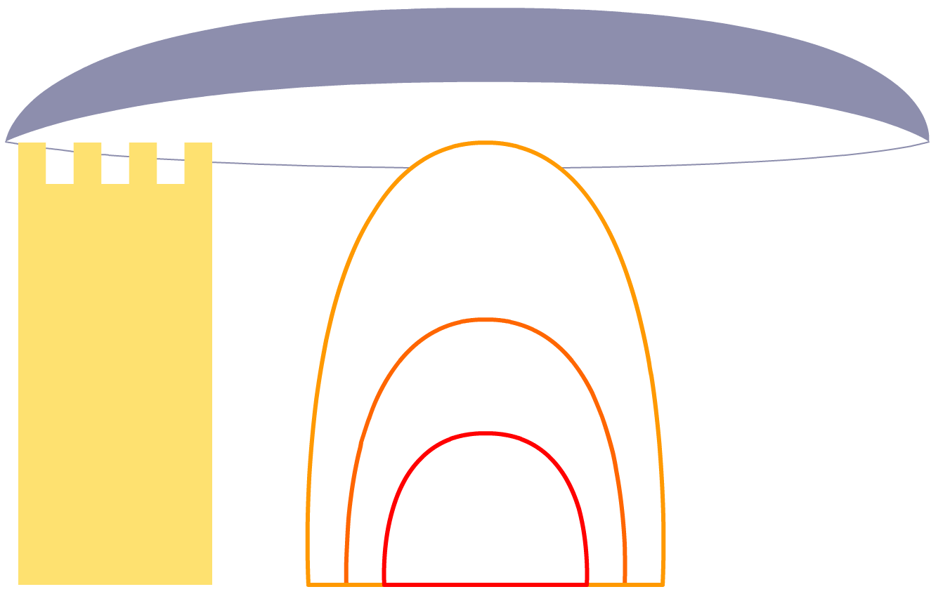
Spheres of EL ideologies
d. International - Worldwide
a. Academia
c. National
c. Regional
b. Local
Endangered
Language
Field linguist

Slide 14
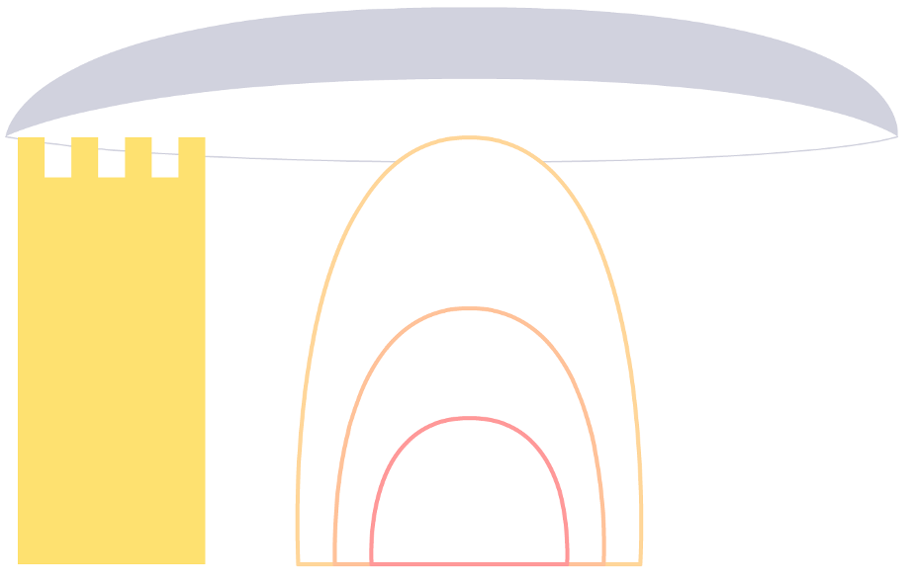
The Academic sphere
● Foundations for EL
DEL 2006
HRELP 2002
VW 1998 + FEL and ELF
 Linguists organizations
Germany –GBS 1997
USA - LSA 1992
Australia - ALS 1984
 Individual field linguists
Desk / field ; theory / description
Fieldwork frameworks: ON / FOR / WITH …/BY Description Documentation Archiving + Revitalization
Academia
Field linguist

Slide 15
The evolution of “documentary linguistics” Description… > Documentation-Archiving… > Revitalization
D “Description” 70ies
vs “theory” in Chomskyan era
More and more by linguists, not anthropologists
D “Documentation”: 90ies
a new sub-discipline of EL
VW DOBES Standards
A “Archiving”:
new technologies
R “Revitalization”…
revalorization, consolidation, support…
D D A + R

Slide 17
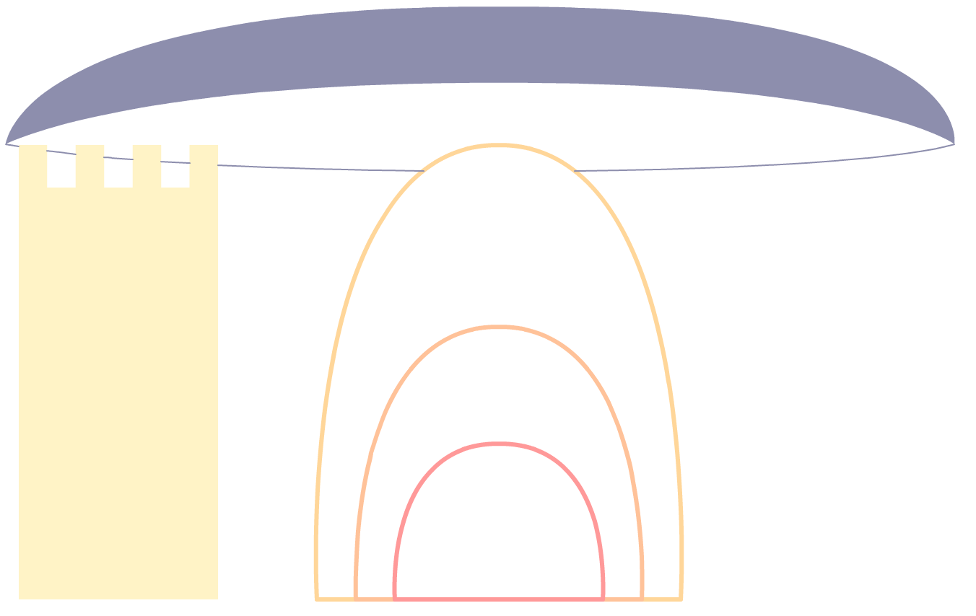
Synergies at the international – worldwide level
International - Worldwide
United Nations
Indigenous rights
UNESCO
2003 Intangible Heritage
2008 International Year of Languages
2009 New edition of the Atlas of EL
& World Report on cultural diversity
UNICEF
Local educational programs
NGO – Media
Biodiversity
WWF – World Wildlife
Foundation
Climate
IPCC – Intergovernmental
Panel on Climate Change
Indigenous rights
Survival International
FOUNDATIONS
for EL

Slide 18
The information contained in this talk can be found in :
Grinevald, C & J. Costa, 2010, Langues en danger: le phénomène et la réponse des linguistes, in Grinevald, C. & M. Bert eds Linguistique de terrain sur langues en danger: Locuteurs et linguistes, Faits de Langues 35-36, Paris, Ophrys, pp. 23-37.
Grinevald, C & Bert, M. 2009. Whose ideology, where and when ? Rama (Nicaragua) and Francoprovençal (France) experiences. ELAP Workshop: Beliefs and Ideology (to appear in Austin & Sallabank, OUP)

Slide 19
4. Today’s programme
Field Linguists, Consortium 3L, EL Foundations, UNESCO:
VW DOBES Documentation pilot project , Argentina (Vidal, Golluscio)
Training for documentation (Ameka)
HRELP ELAP (J. Sallabank) ELAR (D. Nathan)
HRELDP PostDoc Brazil (J. Meyer, Galucio)
NSF/DEL IN-field/COlang (C. Genetti)
CTLDC Consortium on training for Language Documentation and Conservation
UNESCO Atlas of Endangered Languages (A. Minasyan)

Slide 20
The 1992 LSA Language debate
Ken Hale, Michael Krauss, Lucille J. Watahomigie, Akira Y. Yamamoto, Colette Craig, LaVerne Masayesva Jeanne, Nora C. England. Endangered Languages, Language, Vol. 68, No. 1 (Mar., 1992), pp. 1-42
http://www.jstor.org/stable/416368
Or
http://www.lsadc.org/info/pdf_files/Endangered_Languages.pdf
http://www.rnld.org/sites/default/files/Hale%20et%20al%201992.pdf
Ladefoged’s response http://www.jstor.org/stable/pdfplus/416854.pdf?acceptTC=true
Dorian’s response to Ladefoged http://www.jstor.org/stable/pdfplus/416699.pdf

